Slide 1

STANLEY COLLEGE OF ENGINEERING AND TECHNOLGY FOR WOMEN (AUTONOMOUS)
Abids. Hyderabad – 500 001
(Affiliated to Osmania University & Approved by AICTE)
(All eligible UGC courses are accredited by NBA & NAAC with ‘A’ Grade)
Department of Computer Science and Engineering
Academic Year: 2025-2026
Internship Presentation
On
StoryCrafter:The A.I-Powered Tale Weaver
Mr.M.Sai Ramakrishna
Assistant Professor
Department of CSE
PRESENTED BY
Avangapuram Sreeja
160622733070

Slide 2
INTERNSHIP - II DETAILS
Course Code: SPW611 CS Credits: 1 Evaluation: CIE - 50 Marks
Title: StoryCrafter:TheAI-PoweredTale Weaver
Name of the Student: Avangapuram Sreeja
Roll Number: 160622733070
Batch / Section: 2024 – 2025 / B
Name of the Organization: VaultofCodes
Duration of Internship: From 01st May 2025 to 01st June 2025
Mode (Onsite / Online / Hybrid) : Online
Industry Supervisor:
Faculty Coordinator / Supervisor: Mr.M.Sai Ramakrishna

Slide 3
Contents
Abstract
Problem Statement
Background and Literature Review
Planning and Design of Work
Implementation and Execution
Testing / Validation
Results and Analysis
Challenges and Solutions
Conclusion and Future Scope
References

Slide 4
Abstract
The project focuses on developing an intelligent Al-based storytelling system capable of generating creative, coherent, and personalized narratives based on user inputs. By using advanced Natural Language Processing (NLP) methods and large language models, the system understands prompts such as genre, characters, and themes to produce human-like stories. It also integrates code-generation capabilities, enabling the creation of simple interactive storytelling applications. Technologies such as Python, OpenAI API, and machine learning libraries were used to analyze input patterns, understand context, and generate fluent outputs. Overall, the project aims to combine creativity and automation, offering an efficient tool that supports education, entertainment, and digital content creation

Slide 5
1. Problem Statement
In today's digital era, creating meaningful andengaging stories requires creativity, time, and strong writing abilities, which many users may not possess. Traditional storytelling tools are limited because they rely on predefined templates and cannot adapt to user preferences, leading to repetitive and non-personalized outputs. Early Al text generators often struggled with coherence, producing content that lacked flow and context. There is therefore a need for an intelligent system that can interpret natural language prompts, maintain story continuity, and produce human-like narratives. The challenge also lies in generating corresponding code that aligns with the story for interactive and dynamic storytelling. This project addresses these issues by creating an Al-powered storytelling assistant that can generate imaginative, context-aware narratives and relevant code outputs based on user input.

Slide 6
2. Background and Literature Review
Al and NLP now generate human-like stories.
Old models lacked coherence and creativity.
Transformers like GPT-2, GPT-3 improved long-context storytelling.
Plan-and-Write models helped maintain story flow.
Codex and CodeBERT enabled natural-language-to-code generation.
Research supports combining story + code generation for better creativity.

Slide 7
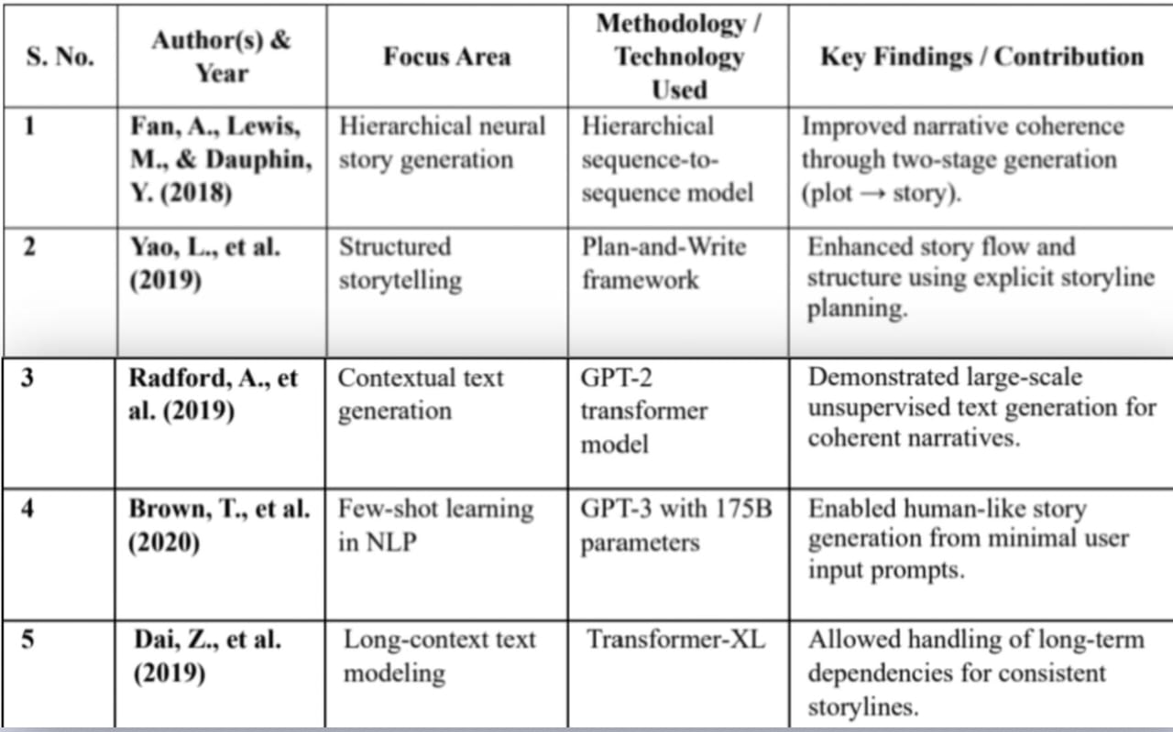
Table 2.1: Summary of reviewed literature on Intrusion Detection Systems

Slide 8
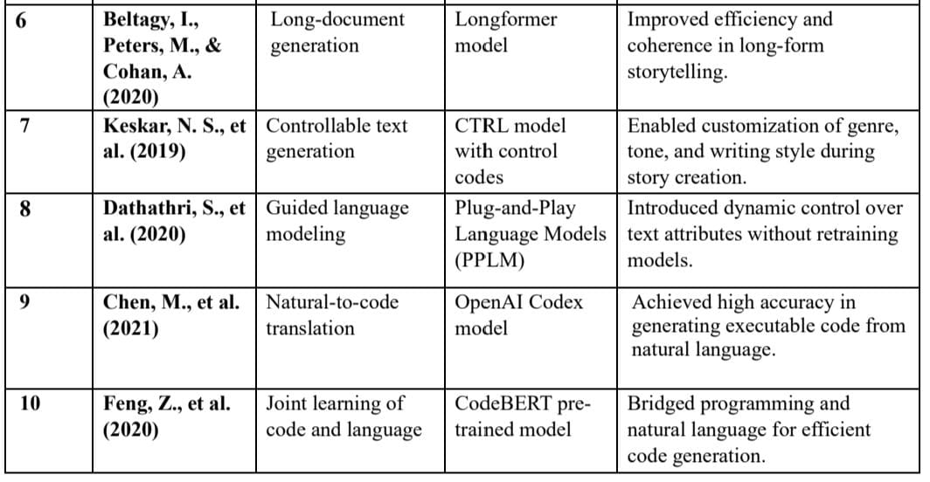
Table 2.1: Summary of reviewed literature on Intrusion Detection Systems

Slide 9
3. Planning and Design of Work
The work was planned across four structureu weeks to ensure smooth and continuous progress.
Initial planning involved understanding project requirements, objectives, and expected outputs.
A detailed literature review was done to study NLP models, story-generation systems, and code-generation tools.
Technologies like Python, OpenAI API, Flask, HTML, CSS, and JavaScript were finalized for development.
Prompt-engineering strategies were designed to maintain coherence, creativity, and control over story style.

Slide 10
System Architecture
Frontend: Chat Ul where user enters prompts and sees output.
Backend API: Passes user messages to Al backend and returns responses.
Conversation Logic: Understands intent, manages context, and controls Al flow.
LLM Model: Generates the story or code based on processed input.
Frontend: Chat Ul where user enters prompts and sees output.
Knowledge Store: Stores reference data for improved replies.
Database: Stores chat history and user details.

Slide 11
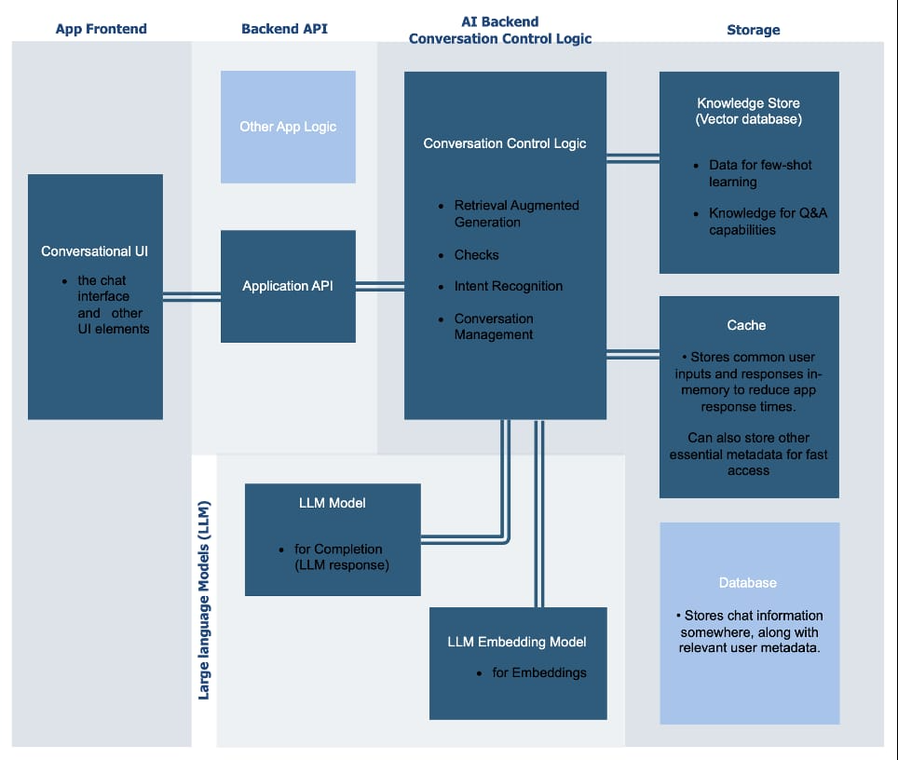
Figure 3.1: System Architecture Diagram

Slide 12
4. Implementation and Execution
The development environment was set up using Python along with required libraries like OpenAI API, Transformers, Flask, and NLTK.
The system was divided into main modules: user input module, Al story-generation module, code-generation module, and output display module.
Backend logic was created to convert user prompts into structured Al-ready inputs and send them to the language model for processing.
A simple and clean frontend interface was built using HTML, CSS, and JavaScript to allow users to enter prompts and view results.
Al integration was implemented using API calls to generate both the story and matching code, ensuring synchronized outputs.
Debugging tools and GitHub version control were used throughout development to improve stability and track updates.

Slide 13
4.1 Pseudocode
START
1. Begin by collecting user inputs such as genre, theme, and characters from the interface.
2. Prepare a structured prompt using the user inputs for the Al model.
3. Send the prompt to the backend API, which forwards it to the Al language model.
4. The Al model processes the prompt and generates the story and matching code.
5. Receive the generated outputs from the Al backend.
6. Display the story and code to the user on the frontend interface.
7. Optionally save user inputs and generated results in the database for future use.
8. Check for any errors and handle failures (invalid input, API issues).
9. Provide the user with the option to regenerate or modify the story.
STOP

Slide 14
CODE FOR EXCEUTION
import subprocess
import json
def generate story idea(genre, theme, character):
prompt = (
f"Generate a creative short story idea in the genre of {genre}, "
f"based on the theme '{theme}', and include a main character who is {character}."
#Run the local model using Ollama
result = subprocess.run(
["ollama", "run", "mistral"],

Slide 15
capture output-True
)
return result.stdout
def main():
print(" Welcome to the Story Generator AI!")
genre = input("Enter genre (e.g., Fantasy, Sci-Fi, Romance): ")
theme = input("Enter theme (e.g., Betrayal, Friendship, Courage): ")
character = input("Describe your main character (e.g., a lonely robot, a brave princess): ")
idea = generate_story_idea(genre, theme, character)
print("\n Your Story Idea:\n")
print(idea)

Slide 16
5. Testing / Validation
Unit testing was performed on individual modules such as input handling, prompt processing, story generation, and code generation to ensure each component worked correctly.
Integration testing verified smoothcommunication between the frontend, backend API, and Al model, ensuring data flowed properly from user input to final output.
Functional testing was carried out using different genres and themes to check the Al's creativity, coherence, grammar, and story flow across various scenarios.
The generated code snippets were tested to ensure they were syntactically correct and matched the context of the story they were based on.
Performance testing evaluated response times, load handling, and system stability during multiple or complex requests.

Slide 17
6. Results and Analysis
1.The system successfully generated creative and coherent stories across multiple genres such as fantasy, adventure, sci-fi, and mystery, showing strong narrative flow and consistency.
2.The Al model demonstrated good contextual understanding, maintaining character behavior, plot direction, and theme alignment throughout the story.
3.Code-generation outputs were accurate and relevant to the generated story, proving the effectiveness of the dual-output design.
4.Performance tests showed reduced response time after optimization, allowing smoother and faster story generation during user interaction.
5.User testing indicated high satisfaction with the simplicity of the interface, clarity of the outputs, and overall ease of using the system.

Slide 18
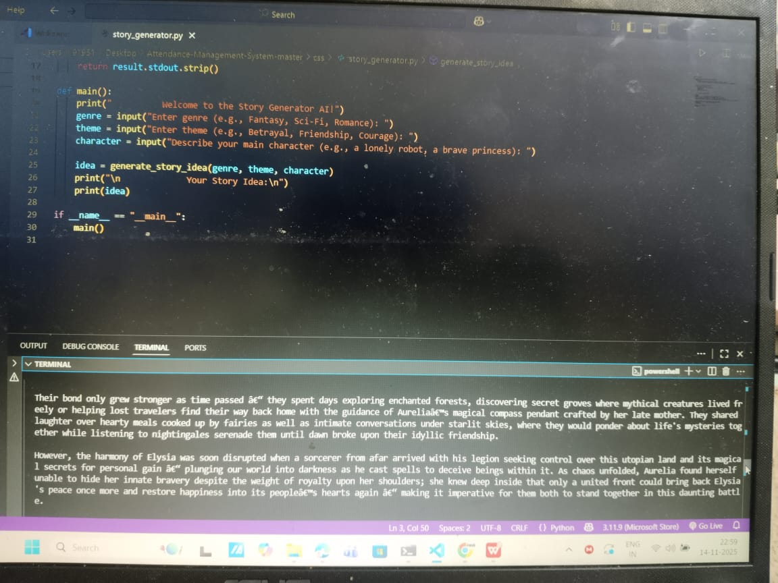
Figure 6.1: Result

Slide 19
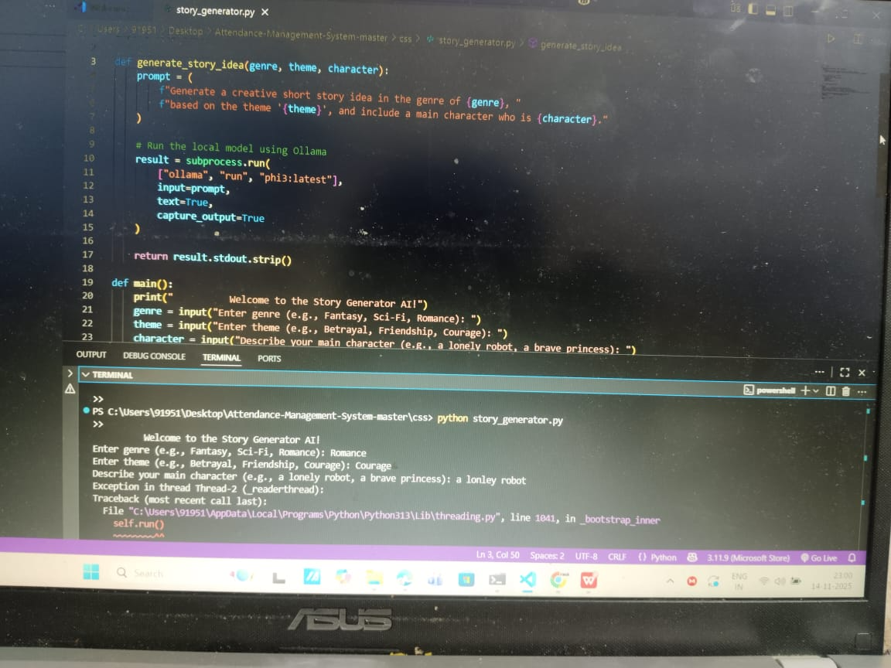

Slide 20
7. Challenges and Solutions
The project faced several issues, including story coherence problems where outputs became repetitive or drifted off-track, which was resolved by using improved prompts and structured templates. There was also a story-code mismatch, fixed by adopting a two-step generation process that produced the story first and the code afterward. Slow response times caused by long prompts were reduced through prompt optimization and caching. Unclear user inputs often led to weak stories, so default keywords and fallback prompts were introduced. Additionally, frontend-backend integration issues affected output display, prompting improvements to API routing and UI flow. Finally, frequent errors and API failures were addressed by implementing stronger error handling and retry logic.

Slide 21
8. Conclusion and Future Scope
The project successfully developed an AI-powered storytelling system capable of generating creative, coherent stories along with matching code based on simple user inputs, demonstrating how NLP and large language models can automate creative writing and make storytelling accessible to users of any skill level. Testing confirmed that the system is stable, user-friendly, and able to produce high-quality narratives across various genres, proving the potential of AI as a valuable tool in education, entertainment, and digital content creation. Looking ahead, the system can be enhanced with features such as image generation, voice narration, animations, and multilingual storytelling, while personalization options, mobile app deployment, and cloud-based processing can further improve performance, expand accessibility, and support a broader user base.

Slide 22
References
Brown, T. B., Mann, B., Ryder, N., et al. (2020). Language Models are Few-Shot Learners. Advances in Neural Information Processing Systems (NeurIPS), 33, 1877-1901.
Vaswani, A., Shazeer, N., Parmar, N., et al. (2017). Attention Is All You Need. Proceedings of the 31st Conference on Neural Information Processing Systems (NeurIPS), 5998-6008.
Radford, A., Wu, J., Child, R., et al. (2019). Language Models are Unsupervised Multitask Learners. OpenAl Technical Report.
Devlin, J., Chang, M. W., Lee, K., & Toutanova, K. (2019). BERT: Pre-training of Deep Bidirectional Transformers for Language Understanding. Proceedings of NAACL-HLT, 4171-4186.
J. Zheng, Y. Liu, and L. Wang, “Industrial Internet of Things intrusion detection system based on graph neural networks,” Symmetry, vol. 17, no. 7, p. 997, 2024.
M. M. Chowdhury, M. R. Islam, and M. M. Rahman, “Deep learning-based intrusion detection system for IoT using recurrent neural networks,” IEEE Access, vol. 11, pp. 45312–45325, 2023.

Slide 23
References
B. Al-Kasasbeh, G. Al-Naymat, and S. Kumar, “A comprehensive review on intrusion detection in IoT networks using deep learning,” Computers, vol. 12, no. 4, p. 87, 2023.
I. H. Sarker, A. S. M. Kayes, and M. Waters, “Cybersecurity data science: an overview from machine learning perspective,” Journal of Big Data, vol. 9, no. 1, pp. 1–30, 2022.
N. Shone, T. N. Ngoc, V. D. Phai, and Q. Shi, “A deep learning approach to network intrusion detection,” Computers & Security, vol. 70, pp. 45–61, 2018.
A. Javaid, Q. Niyaz, W. Sun, and M. Alam, “A deep learning approach for network intrusion detection system,” Proceedings of the IEEE Military Communications Conference (MILCOM), pp. 1–6, 2016.
T. A. Tang, L. Mhamdi, D. McLernon, S. A. R. Zaidi, and M. Ghogho, “Deep learning approach for network intrusion detection in software defined networking,” Proceedings of the IEEE International Conference on Wireless Networks and Mobile Communications (WINCOM), pp. 258–263, 2018.
J. Kim, J. Kim, H. L. T. Thu, and H. Kim, “Long short term memory recurrent neural network classifier for intrusion detection,” Proceedings of the International Conference on Platform Technology and Service (PlatCon), pp. 1–5, 2016.

Slide 24
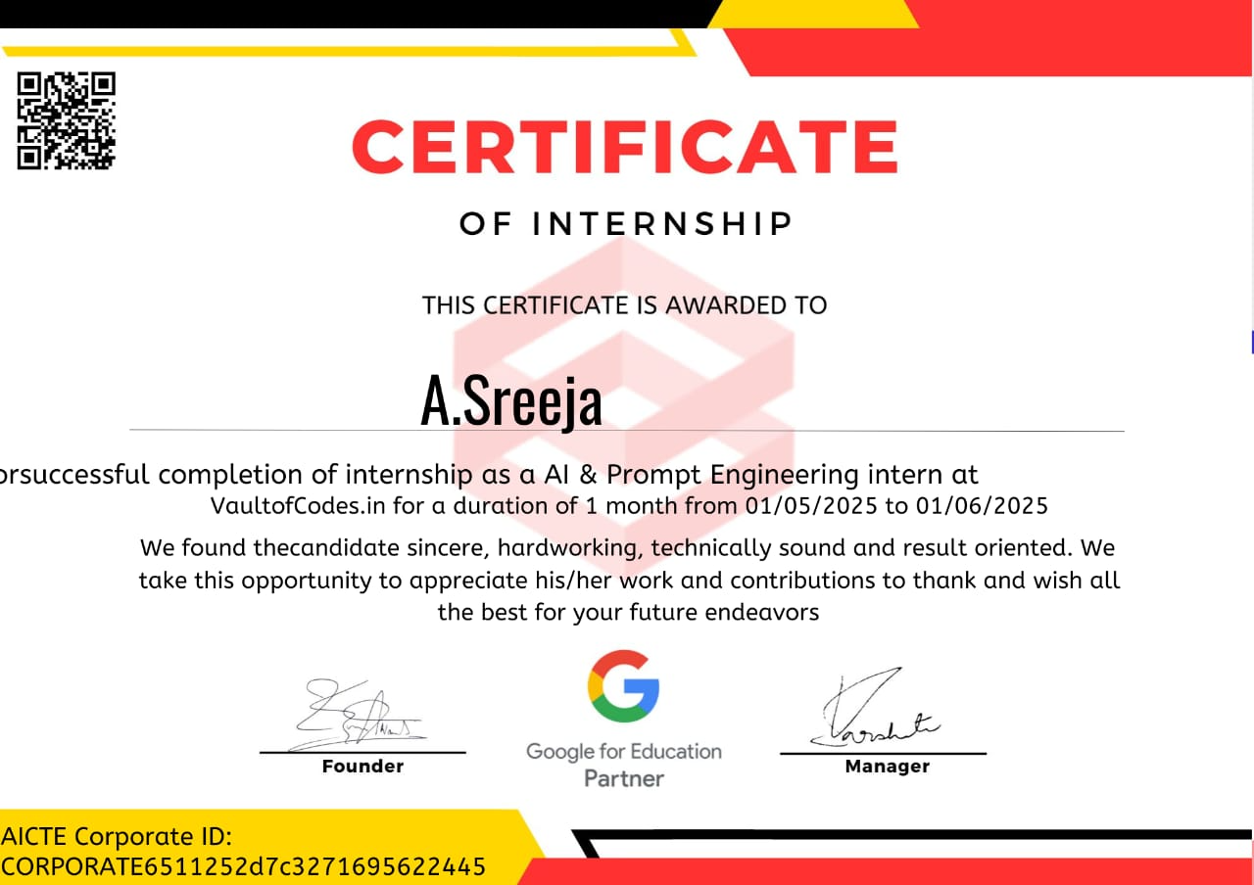
Internship Completion Certificate

